Slide 1
ML ZOOMCAMP
NOTAS DE AULA

Slide 2
How to create a ML system end-to-end?
Environment – Cloud AWS EB / AWS EC2 / Etc
System dependencies
Environment for Python Dependencies (pipenv)
Webservice (Flask)
Model

Slide 3
Summary
- Save models with pickle
- Use flask to turn the model into a web servisse
- Use dependency and env manager
- Package it with docker
- Deploy to the cloud

Slide 4
1. Train a model in some platform
Jupyter notebook
Script
Cloud service

Slide 5
2. Save the model
Model.bin
Model.pkl
Model.h5
SAVE
import pickle
model = ...
with open (‘filename.extension’, ‘wb) as f_out:
pickle.dump(model, f_out)
LOAD
import pickle
with open (‘filename.extension’, ‘rb) as f_in:
model = pickle.load(f_in)

Slide 6
We can use that in multiples models too:
dv = DictVectorizer().fit(…)
model = model.fit(…)
Save:
with open(output_file, 'wb') as f_out:
pickle.dump((dv, model), f_out)
Load:
with open(model_file, 'rb') as f_in:
dv, model = pickle.load(f_in)

Slide 7
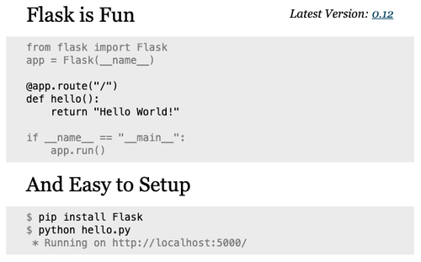
3. Create a platform to encapsulate or Interact with model
Flask web app

Slide 8
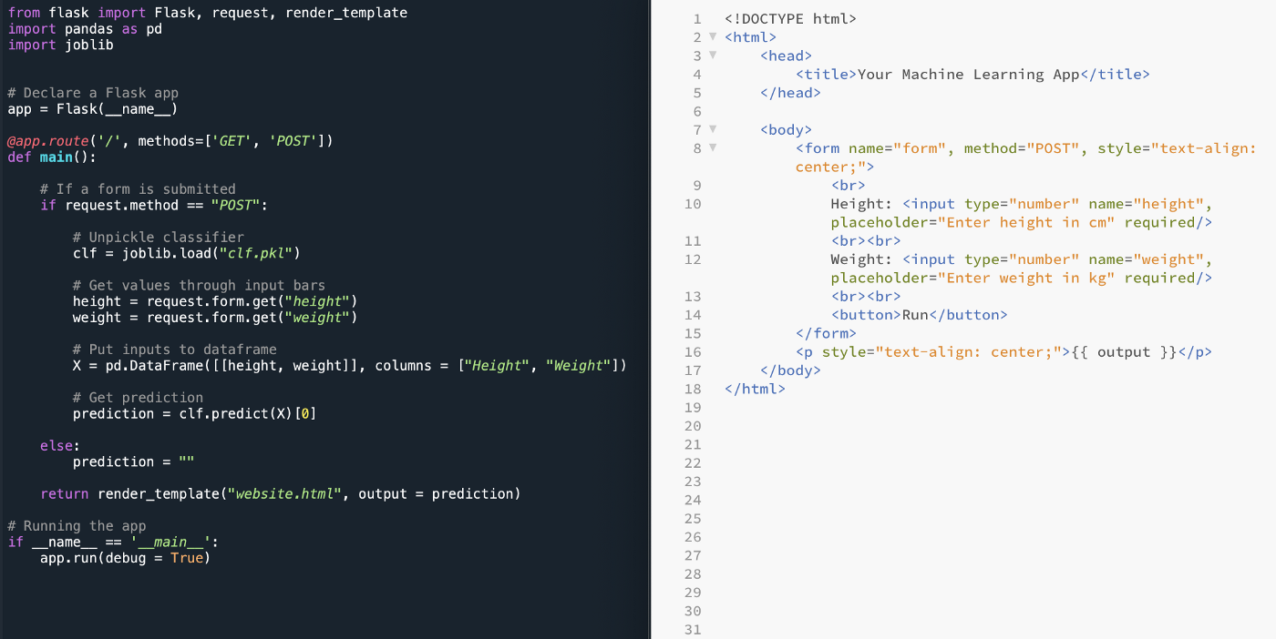
https://towardsdatascience.com/building-a-machine-learning-web-application-using-flask-29fa9ea11dac

Slide 9
Writing a simple ping/pong app
pip install flask
from flask import Flask
app = Flask('ping')
@app.route('/ping', methods=['GET'])
def ping():
return 'PONG'
if __name__ == "__main__":
app.run(debug=True, host='0.0.0.0', port=9696)

Slide 10
Communicate with web server
curl http://0.0.0.0:9696/ping
>> PONG
or
curl http://localhost:9696/ping
or
browser of your choice: http://localhost:9696/ping

Slide 11
4. Serving the churn model with Flask
Wrapping the predict script into a flask app
Querying it with 'requests'
Preparing for production: gunicorn
Running it on windows with waitress

Slide 12
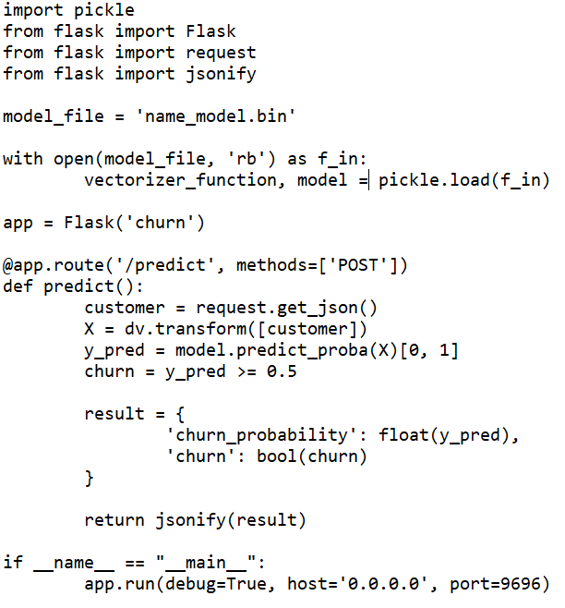
Wrapping the predict script into a flask app

Slide 13
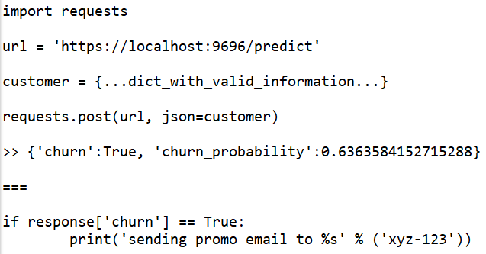
Querying it with 'requests'
python predict.py
{'churn':True, 'churn_probability':0.6363584152715288}

Slide 14
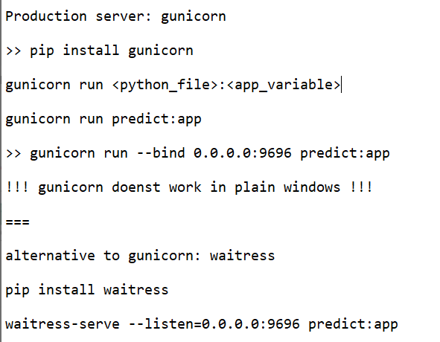
Preparing for production: gunicorn

Slide 15
5. Dependency and environment management: Pipenv
Installing pipenv
Installing libraries with Pipenv
Running things with Pipenv

Slide 16
Virtual Environments
virtual env /venv
conda
conda create -n <name> python=<version>
conda activate <name>
pipenv
poetry

Slide 17
Pipenv
pip install pipenv
pipenv install numpy pandas scikit-learn=0.24.2 flask
pipenv gunicorn
===
Creates "Pipfile" and "Pipfile.lock"
- Pipfile
packages, versions, dev-packages, python version
- Pipfile.lock
metadata of packages, hashes of the specific version for reproducibility

Slide 18
Pipenv
In a new computer, with the files we can just digit:
>> pipenv install
Inside of the virtual environment (similar to ACTIVATE the environment):
>> pipenv shell
We can initiate the web
>> gunicorn --bind 0.0.0.0:9696 predict:app
We can skip the enter in virtual environment step running:
>> pipenv run [what i want to run]
>> pipenv run gunicorn --bind 0.0.0.0:9696 predict:app

Slide 19
6. Environment Management - Docker
Running python image with docker
Dockerfile
Building docker image
Running docker image

Slide 20
Running python image with docker
docker run python:3.8.12-slim
docker run -it --rm python:3.8.12-slim #acess cli
-it -> iterative shell
--rm -> will download and remove from system
The standard "entrypoint" for "-it" of the image python:3.8.11-slim is a terminal with python:
>> import bla...
We can change that:
docker run -it --rm --entrypoint=bash python:3.8.11-slim

Slide 21
We can change that:
docker run -it --rm --entrypoint=bash python:3.8.11-slim
Now it will open the BASH instead:
>> apt-get update
>> ls
>> mkdir
>> ls
>> pwd
Etc
It will only affect the docker environment, we can run for example:
>> pip install pipenv

Slide 22
How to build a dockerfile
FROM <image>
RUN <command_line_commands>
WORKDIR <name> # creates dir and cd into it
COPY [...files...] # list of files
EXPOSE <port>
ENTRYPOINT <commando_line_commands>

Slide 23
How to build image from dockerfile
>> docker build -t zoomcamp-test .
>> docker run -it --rm --entrypoint=bash zoocamp-test
# we can install the things using bash for example, but is better just use the dockerfile.
-t: the tag that is associate with the image

Slide 24
DOCKERFILE
FROM python:3.8.11-slim
RUN pip install pipenv
WORKDIR /app
COPY ["Pipfile", "Pipfile.lock", "./"]
RUN pipenv install --system --deploy
COPY ["predict.py", "model_name.bin", "./"]
EXPOSE 9696
ENTRYPOINT ["gunicorn", "--bind=0.0.0.0:9696", "predict:app"]
And we run:
>> docker build -t zoomcamp-test .
>> docker run -it -p 9696:9696 --rm zoomcamp-test
Now we can use python test-script.py OR test the api and it will work!

Slide 25
7. Deploying
Standard EC2:
> Create AWS account
> Create a EC2
> ssh into it -> ssh <mapped_url> -> ex: ssh zoomcamp-ec2
> scp the files
> etc

Slide 26
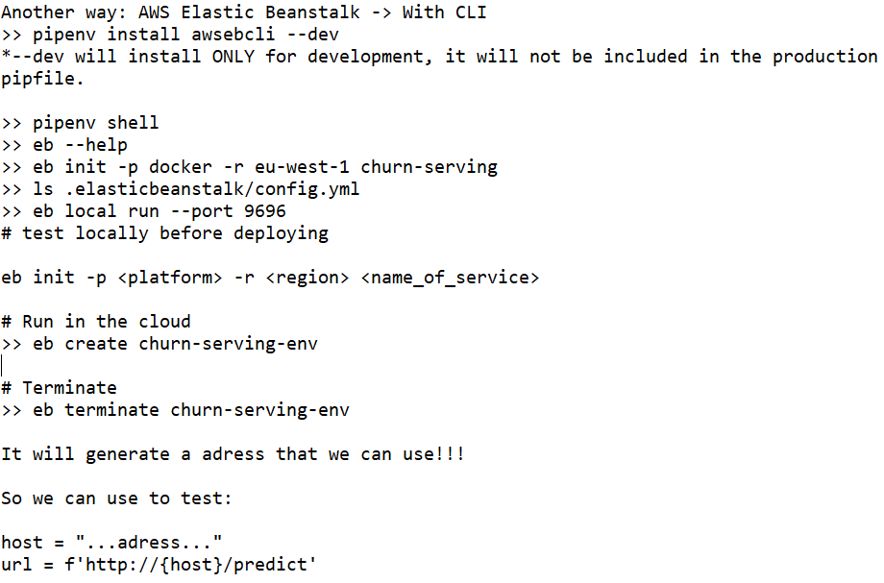
7. Deploying – Elastic Beanstalk (Load Balancer)

Slide 27
Steps
- Create flask or html or etc
- Create Dockerfile, (Ex: nginx image for html...)
>> aws configure #to verify credentials
>> eb --version
>> eb init
>> eb create # will create with default settings
>> eb list
>> eb status
Just two commands to deploy: eb init and eb create.
How to update application?
>>eb deploy # create another version
>> eb terminate --force # to delete all the resources EXCEPT the s3 bucket.
>> eb list

Slide 28
7. Deploying – Elastic Beanstalk (Load Balancer)
Tutorial: https://www.youtube.com/watch?v=4oCjtzxWWJs&ab_channel=JustmeandOpensource
Another example:
https://sommershurbaji.medium.com/deploying-a-docker-container-to-aws-with-elastic-beanstalk-28adfd6e7e95

Slide 29
MLFlow
ML Experiment: Process of building a model.
Experiment run: Each trial in a ML experiment.

Slide 30
Experiment Tracking
Experiment Tracking - Process of keeping track of all the RELEVANT INFORMATION from an ML Experiment, which incluses:
- Source code
- Environment
- Data
- Model
- Hyperparameters
- Metrics
- ...

Slide 31
Why use Experiment Tracking?
- Reproducibility
- Organization
- Optimization

Slide 32
MLFLOW
Open source platform for machine learning lifecycle
It's a python package that can be installed with pip, contains four modules:
- Tracking
- Models
- Model Registry
- Projects (Out of the scope in the course)

Slide 33
MLFlow tracking allows you to organize experiments into runs, keeping track of:
- Parameters
- Metrics
- Metadata
- Artifacts
- Models
Along with this, MLFlow automatically logs extra information about the run:
- Source code
- Version of the code (git commit)
- Start and end time
- Author

Slide 34
1. How to install?
pip install mlflow
>> mlflow #show the possibles commands
Lauch MLFlow web server locally:
>> mlflow ui

Slide 35
2. Set database and model registry
To use model registry (Models tab) you need to run MLFlow with a backend database.
>> mlflow ui --backend-store-uri sqlite:///mlflow.db

Slide 36
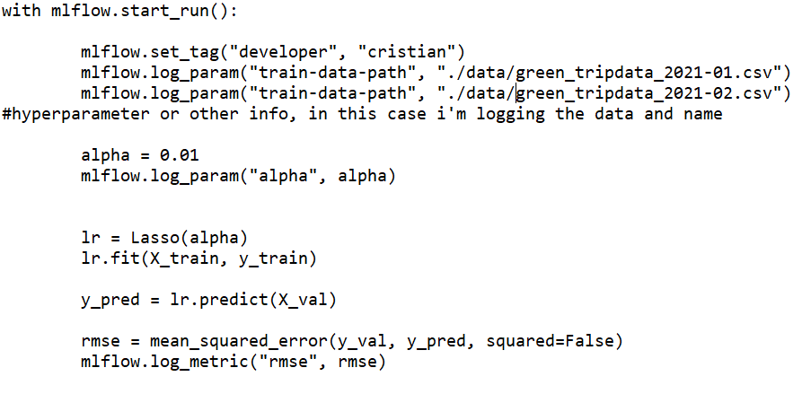
3. How to work with mlflow?
- mlflow.set_tag() # data about the developer for example
- mlflow.log_param() # all kind of parameters or info to be logged
- mlflow.log_metric() # results/metrics

Slide 37
*The source code is not detected if used in a Jupyter Notebook, so it will not be showed in the mlflow tracking.
If you use a script it will appear in the source code section!

Slide 38
EXPERIMENT TRACKING WITH MLFLOW
- Add parameter tuning to notebook
- Show how it looks in MLFlow
- Select the best one
- Autolog

Slide 39
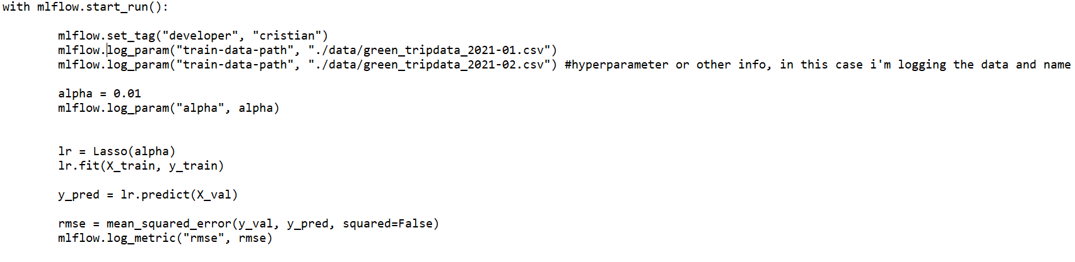
EXPERIMENT TRACKING WITH MLFLOW

Slide 40
Autolog
Alguns frameworks permitem mlflow.autolog()
Por exemplo, xgboost seria: mlflow.xgboost.autolog()
mlflow.xgboost.autolog()
booster = xgb.train(...params...)
ou
mlflow.<framework>.autolog() # consultar no site!
framework.train()
...

Slide 41
Autolog
# enable autologging
mlflow.sklearn.autolog()
# prepare training data
X = np.array([[1, 1], [1, 2], [2, 2], [2, 3]])
y = np.dot(X, np.array([1, 2])) + 3
# prepare evaluation data
X_eval = np.array([[3, 3], [3, 4]])
y_eval = np.dot(X_eval, np.array([1,2])) + 3
# train a model
model = LinearRegression()
with mlflow.start_run() as run:
model.fit(X, y)
metrics = mlflow.sklearn.eval_and_log_metrics(model, X_eval, y_eval, prefix="val_")

Slide 42
MODEL MANAGEMENT with MLFLOW
mlflow.log_artifact(local_path = "models/ling_reg.bin", artifact_path = "models_pickle/")
--local_path: onde está salvo o modelo
-- artifact_path: onde ficará salvo no mlflow
OU
mlflow.log_artifact(<arquivo_do_modelo>, artifact_path="models_pickle/")
OU
mlflow.<framework>.log_model(model, artifact_path = "models/")
OU
The autolog, logs the model automatically.
mlflow.xgboost.autolog(disable=True) para desativar.

Slide 43
mlflow.log_params() aceita um dicionario
Ex:
params={
"param1":param1,
"param2":param2,
...
}

Slide 44
Saving model and preprocessor
with open("models/preprocessor.b","wb") as f_out:
pickle.dump(dv, f_out)
mlflow.log_model("models/preprocessor.b", artifact_path="preprocessor")
mlflow.log_model(model, artifact_path="models_mlflow")
===
Predict using MLFLOW importing model as PYFUNC:
import mlflow
logged_model = "runs/:<see code in mlflow>"
loaded_model = mlflow.pyfunc.load_model(logged_model)

Slide 45
mlflow.log_artifact() only work with PATHS
mlflow.<framework>.log_model() work with models

Slide 46
Model Registry
"Register Model" in my models folders after enter in the mlflow experiment.
Register Model
- Create Model
- Model Name: choose some name, example: nyc-taxi-regressor
We can register another model in the same name, which will be a v2
===
In the Models tab we can see all the registered version models and apply DESCRIPTION or explanation ou tags, etc.
===
We can move the models to staging, dev, production.
- staging -> we will compare the two

Slide 47
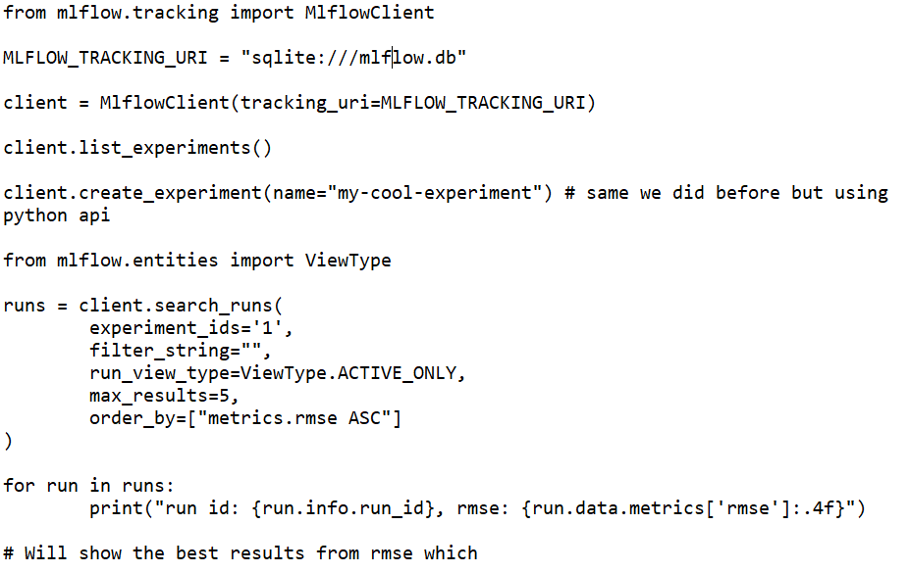
Using MLFLOW Python API to see the experiments and results (same we did with the UI)

Slide 48
runs = client.search_runs(
experiment_ids='1',
filter_string="metrics.rmse < 6.8",
run_view_type=ViewType.ACTIVE_ONLY,
max_results=5,
order_by=["metrics.rmse ASC"]
)
for run in runs:
print("run id: {run.info.run_id}, rmse: {run.data.metrics['rmse']:.4f}")
# Will show the best results from rmse which is lower than 6.8

Slide 49
Register/promoting the model
import mlflow
mlflow.set_tracking_uri(MLFLOW_TRACKING_URI)
run_id = <run_id>
model_uri = f"runs:/{run_id}/model"
mlflow.register_model(model_uri=model_uri, name="nyc-taxi-regressor")
# WE DID THE SAME WE DID BEFORE WITH THE MLFLOW API INSTEAD OF THE MLFLOW UI!!!!

Slide 50
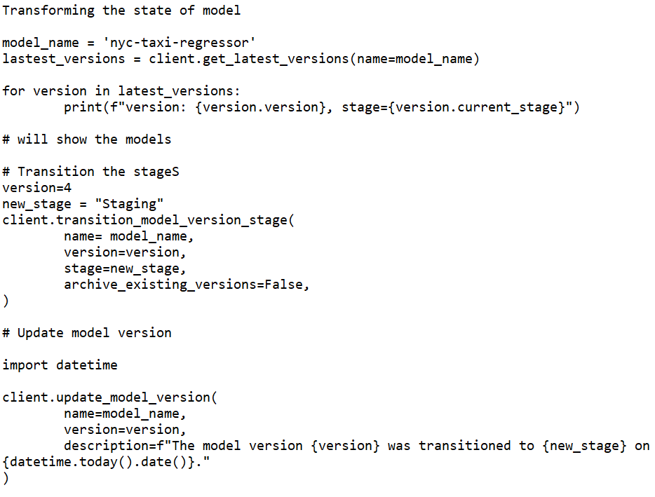
Transforming the state of model

Slide 51
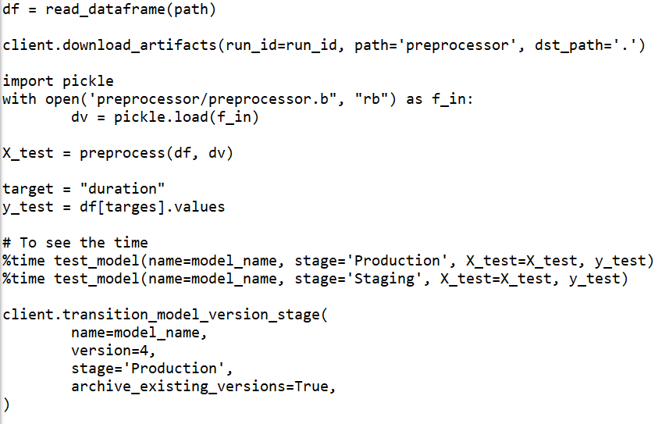

Slide 52
Example
https://github.com/pkams/MLOps-Zoomcamp/blob/main/Week%202%20-%20MLFlow/Notebook%20with%20all%20the%20steps%20to%20train%2C%20tuning%2C%20tracking%20and%20register%20model%20using%20MLFLOW.ipynb

Slide 53
Prefect
- What is Negative Engineering?
- What is Workflow Orchestration?

Slide 54
Set of tools that we can schedule and manage pipeline
Example of ML Pipeline:
- PostgresSQL -> parquet -> REST API -> Pandas -> MLFlow / ScikitLearn -> Flask
Example of DataViz Pipeline:
- PostgresSQL -> parquet -> pandas -> another PostgresSQL -> Tableau

Slide 55
Negative Engineering
90% of engineering time spent
- Retries when APIs go down
- Malformed data
- Notifications
- Observability into Failure
- Conditional Failure Logic
- Timeouts

Slide 56
2. Introducing Prefect
Eliminating Negative Engineering
- Opensource workflow orchestration
- Python-based
- Modern data stack
- Native Dask Integration
- Very active community
- Prefect Cloud/Prefect Server
- Prefect Orion (Prefect 2.0)
Prefect Core (1.0)
Prefect Orion (2.0)

Slide 57
Embracing dynamic DAG-free workflows
Embracing dynamic DAG-free workflows
Transparent and Observable orchestration rules
from prefect import flow, task
@task(retries=3)
def get_something(input):
<do_something>
@flow(name='My Flow')
def my_flow_function(inputs):
for input in inputs:
get_something(input)
# run the flow!
my_flow_function([input1, input2])

Slide 58
3. Install and run server
pip install prefect==2.0b5 (stable version we are using in the course)
prefect orion start (#start UI server)
extra commands:
prefect config view
prefect config unset PREFECT_ORION_UI_API_URL

Slide 59
Task Runner
@flow(flow_runner=ConcurrentTaskRunner()) -> the default setting, prefect will try to optimize the flow, making the independent functions running as concurrent functions.
import prefect.taks_runners import SequentialTaskRunner
@flow(flow_runner=SequentialTaskRunner()) -> Make sequencial

Slide 60
4. Deploy Prefect Orion Server
- Open port on AWS VM
- Install Prefect on VM
- Configure Prefect to server as remote host
- Start Prefect Orion
- View it from local Browser

Slide 61
EC2 and Inbound Rules configuration
# Create EC2 instance
# Add security group rules
HTTP >> Anywhere
Custom TCP >> 4200 >> Anywhere
Custom UDP >> 4200 >> Anywhere
HTTPS... (não sei se precisa)

Slide 62
ssh into the machine
# ssh to public id (use the key)
# ssh -i ~/Work/prefect.pem <name>@<ip>
# install conda
# pip install prefect
# Configure the prefect server (follow instructions)
https://discourse.prefect.io/t/hosting-an-orion-instance-on-a-cloud-vm/967
# external ip is the ip of the VM
# prefect config view to verify if is setted
# if needed to change prefect config unset
# prefect orion start -- host 0.0.0.0
# <ip>:4200 no navegador!
# Set the endpoint in the local machine
Exemplo: prefect config set PREFECT_API_URL='http://3.1.7.74.178:4200/api"

Slide 63
Prefect Cloud
We can use prefect cloud as alternative.

Slide 64
5. Deployment of Prefect Flow
>> prefect storage ls
>> prefect storage create
>> 3 (local storage)
>> path: /Users/myname/.prefect
in the code we will write deployment

Slide 65
from prefect.deployments import DeploymentSpec
from prefect.orion.schemas.schedules import IntervalSchedule
from prefect.flow_runner import SubprocessFlowRunner
from datetime import timedelta
DeploymentSpec(
flow=main,
name='model-training',
schedule=IntervalSchedule(interval=timedelta(minutes=5)),
flow_runner=SubprocessFlowRunner(),
tags=['ml']
)
>> prefect deployment create prefect_deploy.py

Slide 66
Go to the prefect orion (VM) and find WORK QUEUES
Create work queue >> name: global >> create (it will return a ID)
in local >> prefect work-queue preview <id>
# will show all the scheduled works
>> prefect agent start <id of a work> # will start manually the work

Slide 67
Tutoriais:
https://towardsdatascience.com/orchestrate-a-data-science-project-in-python-with-prefect-e69c61a49074
Github: https://github.com/khuyentran1401/Data-science/tree/master/data_science_tools/prefect_example

Slide 68
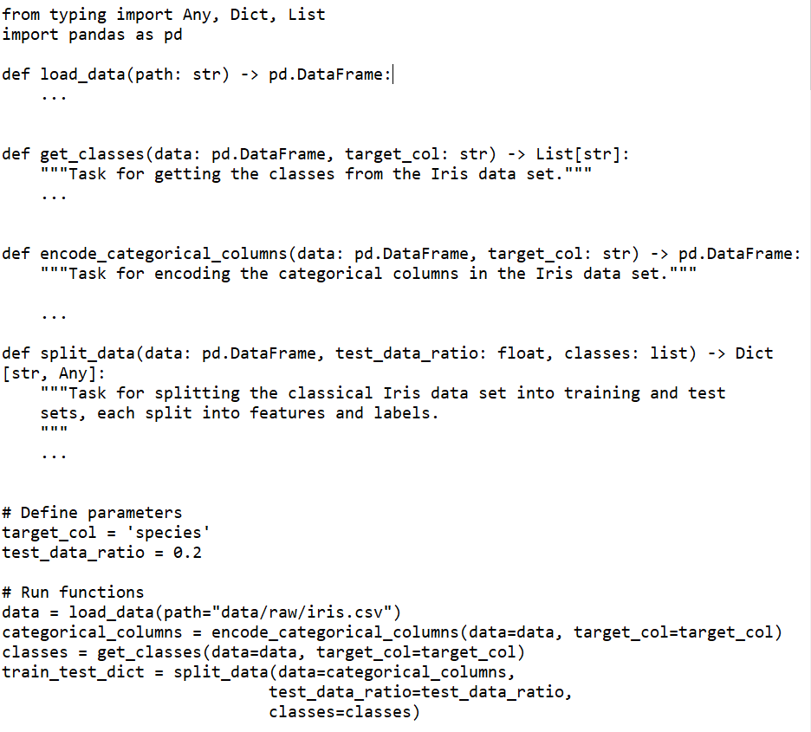
1. Functions

Slide 69
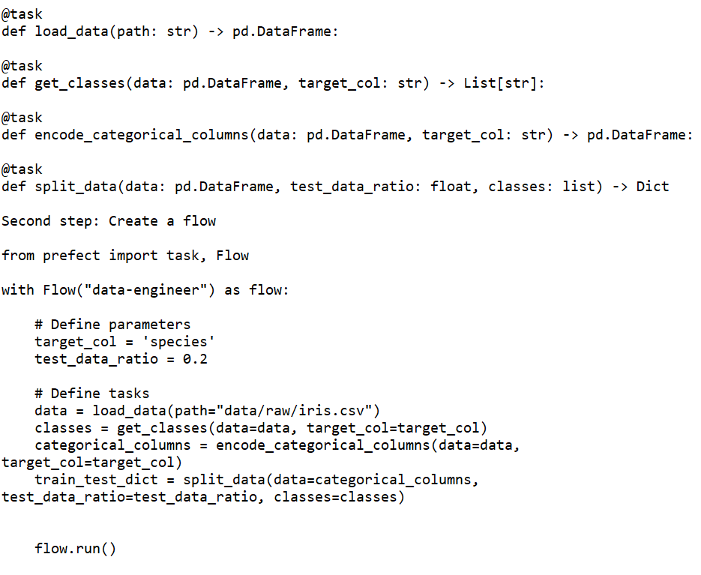
2. Functions – Tasks and Flow

Slide 70
We can use pip install "prefect[viz]" -> flow.visualize() to visualize the graph of the functions

Slide 71
3. Add Parameters
If you find yourself frequently experimenting with different values of one variable, it’s ideal to turn that variable into a Parameter.
test_data_ratio = 0.2
train_test_dict = split_data(data=categorical_columns,
test_data_ratio=test_data_ratio,
classes=classes)
You can consider a Parameter as a Task , except that it can receive user inputs whenever a flow is run. To turn a variable into a parameter, simply use task.Parameter .
from prefect import task, Flow, Parameter
test_data_ratio = Parameter("test_data_ratio", default=0.2)
train_test_dict = split_data(data=categorical_columns,
test_data_ratio=test_data_ratio,
classes=classes)

Slide 72
You can overwrite the default parameter for each run by:
- adding the argument parameters to flow.run()
flow.run(parameters={'test_data_ratio': 0.3})
- or using Prefect CLI:
$ prefect run -p data_engineering.py --param test_data_ratio=0.2
- or using a JSON file:
$ prefect run -p data_engineering.py --param-file='params.json'
JSON: {"test_data_ratio": 0.3}
- You can also change parameters for each run using Prefect Cloud

Slide 73
Monitor Workflow
Prefect Cloud: https://docs.prefect.io/orchestration/getting-started/set-up.html#server-or-cloud
After all of the dependencies are installed and set up, start with creating a project on Prefect by running:
$ prefect create project "Iris Project"
Next, start a local agent to deploy our flows locally on a single machine:
$ prefect agent local start
Then add at the end of your file:
flow.register(project_name="Iris Project")
After running the file, you should see something similar to the below:
Flow URL: https://cloud.prefect.io/khuyentran1476-gmail-com-s-account/flow/dba26bea-8827-4db4-9988-3289f6cb662f
└── ID: 2944dc36-cdac-4079-8497-be4ec5594785
└── Project: Iris Project
└── Labels: ['khuyen-Precision-7740']

Slide 74
Run the Workflow with Default Parameters
Note that the workflow is registered to Prefect Cloud, but it is not executed yet. To execute the workflow with the default parameters, click Quick Run in the top right corner.
Run the Workflow with Custom Parameters
To run the workflow with custom parameters, click the Run tab, then change the parameters under Inputs.
When you are satisfied with the parameters, simply click the Run button to start the run.
View the Graph of the Workflow
Clicking Schematic will give you the graph of the entire workflow.

Slide 75
Other Features
Besides some basic features mentioned above, Prefect also provides some other cool features that will significantly increase the efficiency of your workflow.
Input Caching
Remember the problem we mentioned at the beginning of the article? Normally, if the function get_classes fails, the data created by the function encode_categorical_columns will be discarded and the entire workflow needs to start from the beginning.
However, with Prefect, the output of encode_categorical_columns is stored. Next time when the workflow is rerun, the output of encode_categorical_columns will be used by the next task without rerunning the task encode_categorical_columns .

Slide 76
Persist Output
Sometimes, you might want to export your task’s data to an external location. This can be done by inserting to the task function the code to save the data.
def split_data(data: pd.DataFrame, test_data_ratio: float, classes: list) -> Dict[str, Any]:
X_train, X_test, y_train, y_test = ...
import pickle
pickle.save(...)
However, doing that will make it difficult to test the function.
Prefect makes it easy to save the output of a task for each run by:
- setting the checkpoint to True
$ export PREFECT__FLOWS__CHECKPOINTING=true
- and adding result = LocalResult(dir=...)) to the decorator @task .

Slide 77
Persist Output
@task(result = LocalResult(dir='data/processed'))
def split_data(data: pd.DataFrame, test_data_ratio: float, classes: list) -> Dict[str, Any]:
"""Task for splitting the classical Iris data set into training and test
sets, each split into features and labels.
"""
X_train, X_test, y_train, y_test = ...
return dict(
train_x=X_train,
train_y=y_train,
test_x=X_test,
test_y=y_test,
Now the output of the task split_data will be saved to the directory data/processed ! The name will look something similar to this:
prefect-result-2021-11-06t15-37-29-605869-00-00

Slide 78
Persist Output
- If you want to customize the name of your file, you can add the argument target to @task :
from prefect.engine.results import LocalResult
@task(target="{date:%a_%b_%d_%Y_%H:%M:%S}/{task_name}_output",
result = LocalResult(dir='data/processed'))
def split_data(data: pd.DataFrame, test_data_ratio: float, classes: list) -> Dict[str, Any]:
"""Task for splitting the classical Iris data set into training and test
sets, each split into features and labels.
"""
...
Prefect also provides other Result classes such as GCSResult and S3Result . You can check out API docs for results here.
https://docs.prefect.io/api/latest/engine/results.html

Slide 79
Use Output of Another Flow for the Current Flow
If you are working with multiple flows, for example, data-engineer flow and data-science flow, you might want to use the output of the data-engineer flow for the data-science flow.
After saving the output of your data-engineer flow as a file, you can read that file using the read method:
from prefect.engine.results import LocalResult
train_test_dict = LocalResult(dir=...).read(location=...).value

Slide 80
Connect Dependent Flows
Imagine this scenario: You created two flows that depend on each other. The flow data-engineer needs to be executed before the flow data-science
Somebody who looked at your workflow didn’t understand the relationship between these two flows. As a result, they executed the flow data-science and the flow data-engineer at the same time and encountered an error!
Start with grabbing two different flows using StartFlowRun . Add wait=True to the argument so that the downstream flow is executed only after the upstream flow finishes executing:

Slide 81
Connect Dependent Flows
from prefect import Flow
from prefect.tasks.prefect import StartFlowRun
data_engineering_flow = StartFlowRun(flow_name="data-engineer",
project_name='Iris Project',
wait=True)
data_science_flow = StartFlowRun(flow_name="data-science",
project_name='Iris Project',
wait=True)
Next, calling data_science_flow under the with Flow(...) context manager. Use upstream_tasks to specify the tasks/flows that will be executed before the data-science flow is executed.
with Flow("main-flow") as flow:
result = data_science_flow(upstream_tasks=[data_engineering_flow])
flow.run()

Slide 82
Schedule Your Flow
Prefect also makes it seamless to execute a flow at a certain time or at a certain interval.
For example, to run a flow every 1 minute, you can initiate the class IntervalSchedule and add schedule to the with Flow(...) context manager:
from prefect.schedules import IntervalSchedule
schedule = IntervalSchedule(
start_date=datetime.utcnow() + timedelta(seconds=1),
interval=timedelta(minutes=1),
)
data_engineering_flow = ...
data_science_flow = ...
with Flow("main-flow", schedule=schedule) as flow:
data_science = data_science_flow(upstream_tasks=[data_engineering_flow])
Now your flow will be rerun every 1 minute!
https://docs.prefect.io/core/concepts/schedules.html#overview

Slide 83
Logging
You can log the print statements within a task by simply adding log_stdout=True to @task :
@task(log_stdout=True)
def report_accuracy(predictions: np.ndarray, test_y: pd.DataFrame) -> None:
target = ...
accuracy = ...
print(f"Model accuracy on test set: {round(accuracy * 100, 2)}")

